Slide 1

DATA STRUCTURE CAPSTONE PROJECT
NAME: | SAP ID: | ROLL NO.
ARIHANT VARDHAN | 500086019 | R2142201523

Slide 2
CALENDAR PROGRAM -ARIHANT VARDHAN 500086019 R2142201523

Slide 3
ABOUT MY CALENDAR PROGRAM:
THE CALENDAR PROGRAM I HAVE CREATED HAS BEEN CREATED USING C –LANGUAGE.
THE CALENDAR PROGRAM HAS THREE OPTION:
>>YEARLY CALENDAR>IT DISPLAYS THE WHOLE YEARS CALENDAR ON ENTERING THE YEAR
>>MONTHLY CALENDAR>IT DISPLAYS A PARTICULAR MONTH'S CALENDAR OF A YEAR ON ENTERING MONTH AND YEAR.
>>EXIT>TO EXIT THE PROGRAM
TO ACHIEVE THESE FUNCTION IN MY PROGRAM I CREATED FOUR FN'S:
>>yearlyCalendar()>TO DISPLAY THE YEARLY CALENDAR WITH DAYS AND DATES
>>monthlyCalendar()>TO DISPLAY THE MONTHLY CALENDAR WITH DAYS AND DATES
>>DayOfWeek()>IT RETURNS THE FIRST DAY OF ANY WEEK ON ENTERING MONTH AND THE YEAR TO THE monthlyCalendar()
>>get_First_weekday()>IT RETURNS THE FIRST DAY OF JANUARY ON ENTERING THE YEAR TO yearlyCalendar()

Slide 4
ALGORITHM:

Slide 5
START
STEP 1: include <stdio.h> and <stdlib.h>
STEP 2: in main fn:
STEP2.1: system("Color 0F"); //System fn is called here to add back ground color 0= black and text color F= white
STEP2.2:declare variable int choice;
STEP 2.3: repeat through step 2.10 While choice!=3;[using exit controlled loop]
STEP 2.4:print menu
STEP 2.5:input choice
STEP 2.6:[using switch case check value of choice]switch(choice);
STEP 2.7:If choice =1, then call yearlyCalendar();break;
STEP 2.8:If choice=2, then call monthlyCalendar();break;
STEP 2.9:If choice=3, then print exiting the program and exit loop;break;
STEP 2.10: for default PRINT Entered choice doesn't exist ... please enter correct value
STEP 2.11:Return 0;

Slide 6
STEP 3: IN yearlyCalendar() fn:[WHEN CALLED WILL DISPLAY CALENDAR OF A PARTICULAR YEAR]
STEP 3.1: [declare variable] int year,month,day,daysInMonth,weekDay=0,firstDay;
STEP 3.2:[declare constant] int monthDay[]={31,28,31,30,31,30,31,31,30,31,30,31};
STEP 3.3:[declare pointer array ] char *months[]={"January","Feburary","March","April","May","June","July","August","September","October","November","December"};
STEP 3.4:[Input] int year;
STEP 3.5:if(year%4==0&&year%100!=0) then monthDay[1]=29;[LEAP YEAR CHECK]
STEP 3.6:else if(year%400==0) then monthDay[1]=29;
STEP 3.7: else then monthDay[1]=28;
STEP 3.8:firstDay=get_First_weekday(year);//get_First_weekday() fn to give first day of january.
STEP 3.9 for(month=0;month<12;month++) repeat through step 3.18
STEP 3.10:daysInMonth=monthDay[month];
STEP 3.11:[will show the month name] print months[month]);
STEP 3.12:print days of week;

Slide 7
STEP 3.13:for(weekDay=0;weekDay<firstDay;weekDay++) repeat through step 3.14
STEP 3.14:print spaces;
STEP 3.15:for(day=1;day<=daysInMonth;day++)repeat through step 3.18
STEP 3.16:Print date of the month corresponding to day
STEP 3.17:if(++weekDay>6)then{new line and set weekDay=0; //It is essential to again initialize it to zero otherwise it will only run ones }
>STEP 3.18: Now set,firstDay=weekDay;
STEP 4: IN monthlyCalendar() fn:[WHEN CALLED WILL DISPLAY CALENDAR OF A PARTICULAR MONTH]
STEP4.1:[declare variable] int year,month,day,daysInMonth,weekDay=0,firstDay;
STEP 4.2:[declare constant] int monthDay[]={31,28,31,30,31,30,31,31,30,31,30,31};
STEP 4.3:[declare pointer array] char *months[]={"January","Feburary","March","April","May","June","July","August","September","October","November","December"};
STEP 4.4:[Input] int month,year;check if month>=12 then print Month cannot be greater than 12 else run the code;
STEP 4.5:if(year%4==0&&year%100!=0) then monthDay[1]=29;[LEAP YEAR CHECK]
STEP 4.6:else if(year%400==0) then monthDay[1]=29;

Slide 8
STEP 4.7:else then monthDay[1]=28;
STEP 4.8:FirstDay=dayOfWeek(month,year);
STEP 4.9:[set] month=month-1;
STEP 4.10:will show the month name] print months[month]);
STEP 4.11::print days of week;
STEP 4.12:for(weekDay=0;weekDay<firstDay;weekDay++) repeat through step 4.13
STEP 4.13:print spaces;
STEP 4.14:for(day=1;day<=daysInMonth;day++)repeat through step 4.17
STEP 4.15:Print date of the month corresponding to day
STEP 4.16:if(++weekDay>6)then{new line and set weekDay=0; //It is essential to again initialize it to zero otherwise it will only run ones }
STEP 4.17: Now set,firstDay=weekDay;
STEP 5:IN int dayOfWeek(int m,int y) fn;[to return first dayofweek of the month to monthlyCalendar() fn]
STEP 5.1:[declare]int d=1;
STEP 5.2:[declare]static int t[] = {0, 3, 2, 5, 0, 3, 5, 1, 4, 6, 2, 4};
STEP 5.3:if(m<3) then y=y-1;

Slide 9
STEP 5.4:return (y + y/4 - y/100 + y/400 + t[m-1] + d) % 7;
STEP 6: IN get_First_weekday(int year)[ this fn returns first day of week of january to yearlyCalendar() fn]
STEP 6.1: [declare] int day;
STEP 6.2:day = (((year - 1) * 365) + ((year - 1) / 4) - ((year - 1) / 100) + ((year) / 400) + 1) % 7; // this algo will return 0 for Sunday and 6 for Saturday only works for january
STEP 6.3: return day;
END

Slide 10
FLOWCHART:

Slide 11
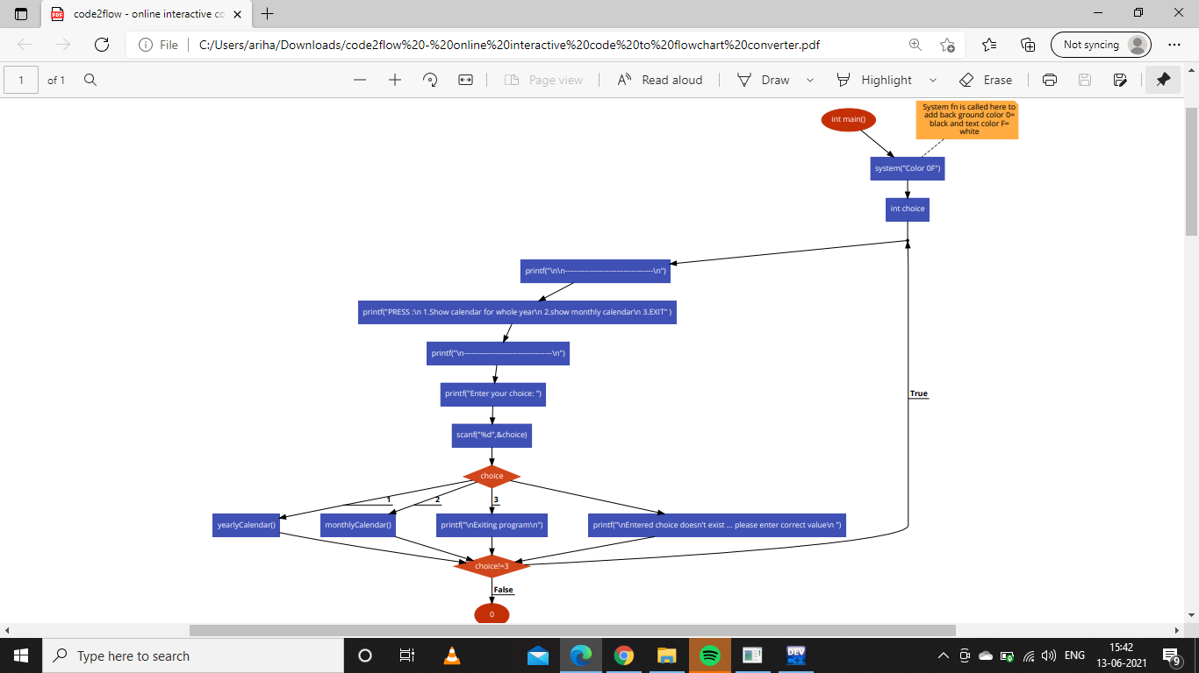
Contd in figure 2
Contd in figure 3

Slide 12
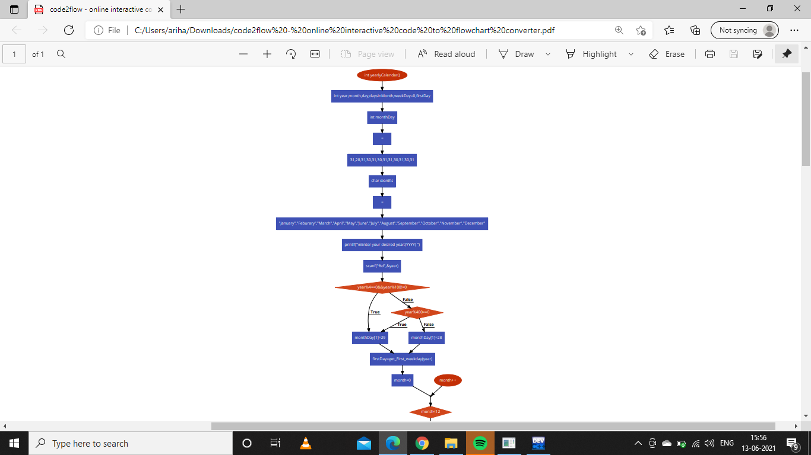
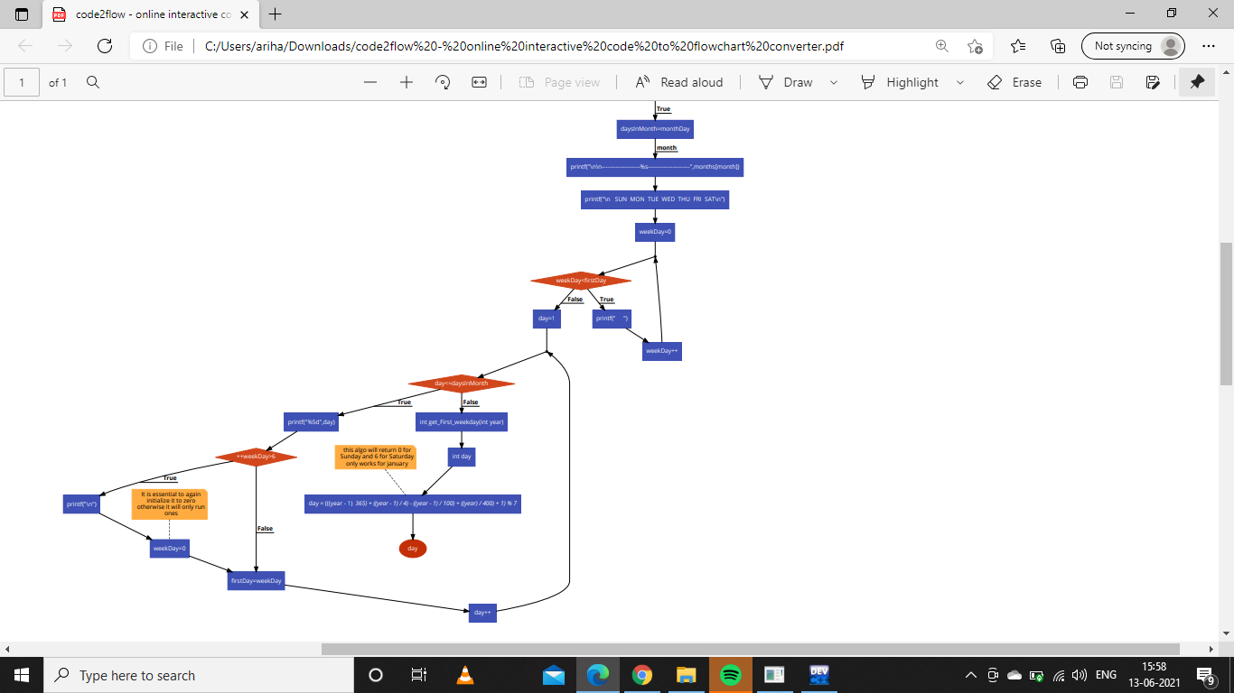
FIGURE 2:

Slide 13
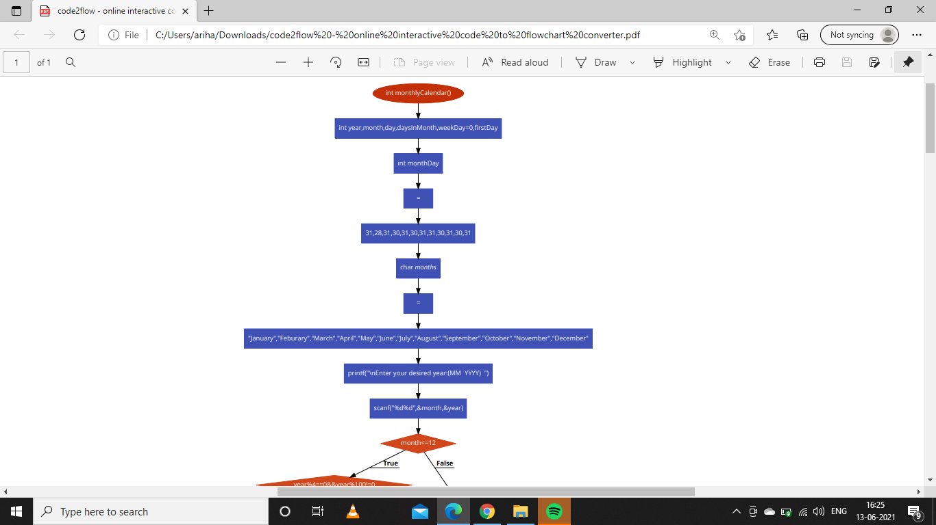
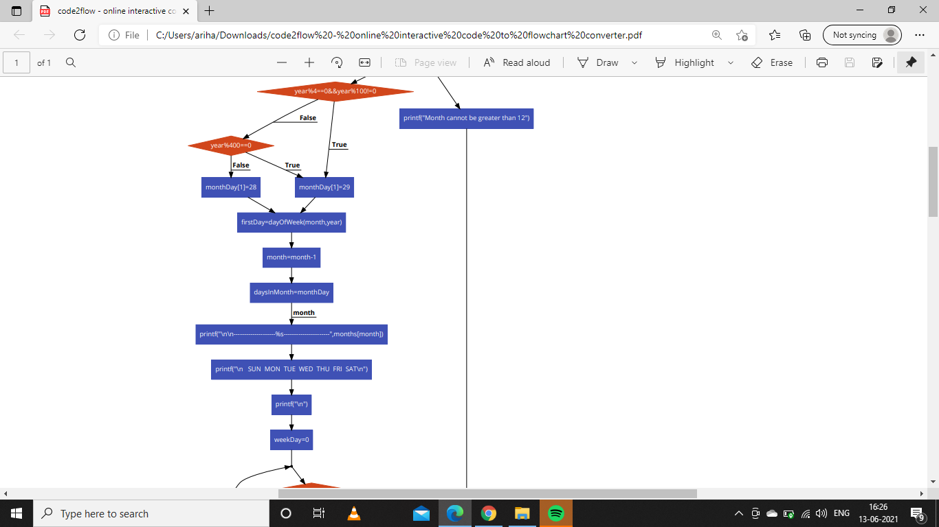
FIGURE 3

Slide 14
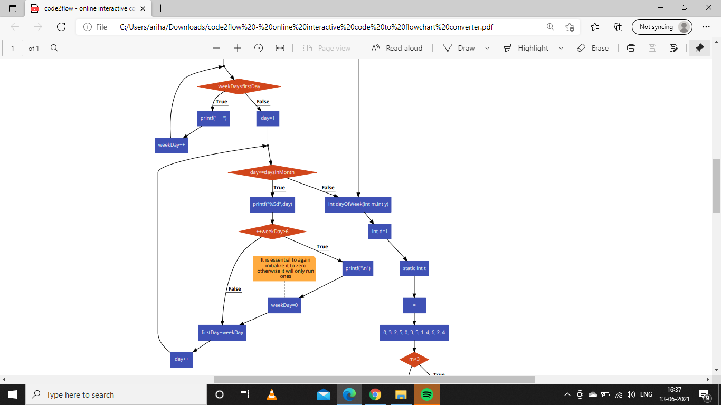
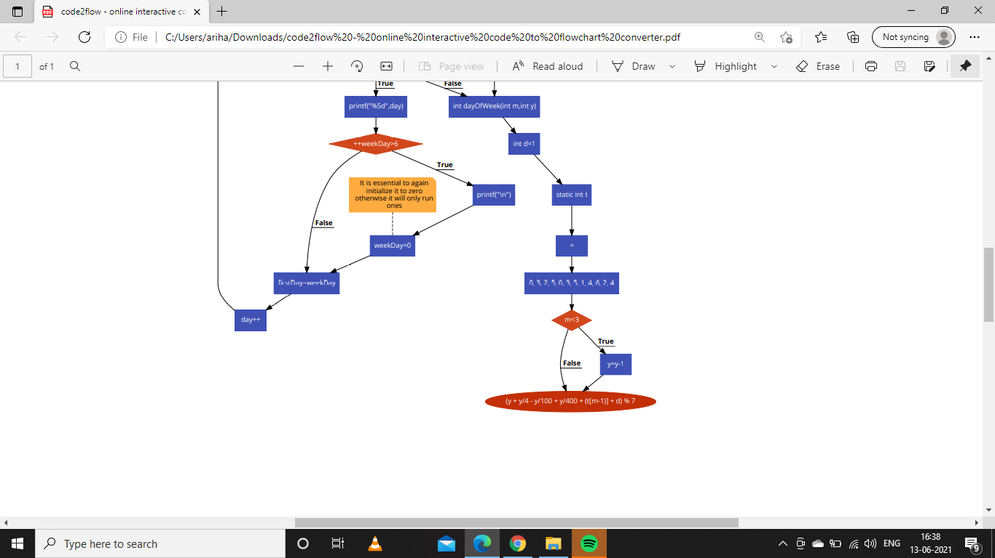
FIGURE 3 CONTINUED...

Slide 15
FUNCTIONS USED IN PROJECT:
Predefined fn included with stdio.h and stdlib.h:
printf(): To print .
scanf():To take input.
Userdefined fn in the program:
yearlyCalendar(): To display the calendar of a whole particular year with days and dates.
monthlyCalendar():To display the calendar of a particular month of a particular year with days and dates.
dayOfWeek(int month,int year):to return first dayofweek of the month to monthlyCalendar() fn.
get_First_weekday():this fn returns first day of week of january to yearlyCalendar() fn.
main(): user defined as well as predefined because it's prototype is predefined.It is the point at which execution of program is started.

Slide 16
TEST CASES:
TEST CASES | INPUT | ACTUAL OUTPUT | DESIRED OUTPUT
SELECT THE FIRST OPTION FROM MENU AND DISPLAY CALENDAR FOR ANY NON-LEAP YEAR. | 1 2021 | DISPLAYS CALENDAR OF 2021 WITH CORRESPONDING DAYS AND DATES FOR EACH MONTH AND FEBRUARY HAS 28 DAYS | DISPLAYS CALENDAR OF 2021 WITH CORRESPONDING DAYS AND DATES FOR EACH MONTH AND FEBRUARY HAS 28 DAYS | PASS
SELECT THE FIRST OPTION FROM MENU AND DISPLAY CALENDAR FOR ANY LEAP YEAR. | 1 2020 | DISPLAYS CALENDAR OF 2021 WITH CORRESPONDING DAYS AND DATES FOR EACH MONTH AND FEBRUARY HAS 29 DAYS. | DISPLAYS CALENDAR OF 2021 WITH CORRESPONDING DAYS AND DATES FOR EACH MONTH AND FEBRUARY HAS 29 DAYS | PASS
SELECT THE SECOND OPTION FROM MENU AND DISPLAY MONTHLY CALENDAR FOR ANY NON-LEAP YEAR | 2 02 2021 | DISPLAYS CALENDAR FOR FEBRUARY MONTH OF 2021 WITH 28 DAYS IN FEBRUARY. ALSO IT DISPLAYS CORRESPONDING DAYS AND DATES | DISPLAYS CALENDAR FOR FEBRUARY MONTH OF 2021 WITH 28 DAYS IN FEBRUARY. ALSO IT DISPLAYS CORRESPONDING DAYS AND DATES | PASS
SELECT THE SECOND OPTION FROM MENU AND DISPLAY MONTHLY CALENDAR FOR ANY LEAP YEAR | 2 02 2020 | DISPLAYS CALENDAR FOR FEBRUARY MONTH OF 2021 WITH 29 DAYS IN FEBRUARY. ALSO IT DISPLAYS CORRESPONDING DAYS AND DATES | DISPLAYS CALENDAR FOR FEBRUARY MONTH OF 2021 WITH 29 DAYS IN FEBRUARY.ALSO IT DISPLAYS CORRESPONDING DAYS AND DATES | PASS
SELECT THE THIRD OPTION FROM MENU AND EXIT THE PROGRAM | 3 | EXIT THE PROGRAM | EXIT THE PROGRAM | PASS
SELECT THE SECOND OPTION AND ENTER MONTH VALUE GREATER THAN 12 | 2 22 2021 | MONTH CANNOT BE GREATER THAN 12 | MONTH CANNOT BE GREATER THAN 12 | PASS

Slide 17
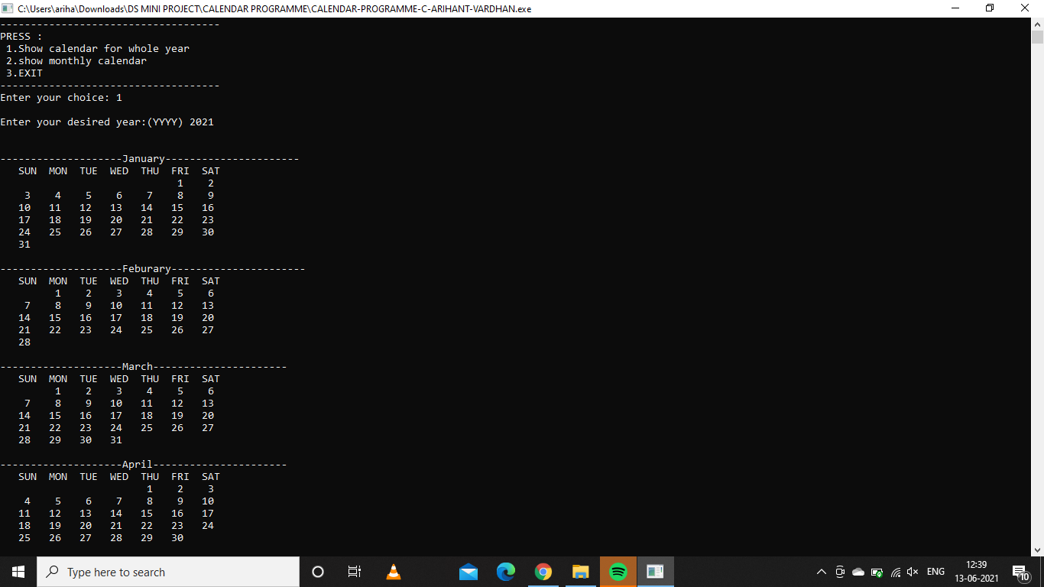
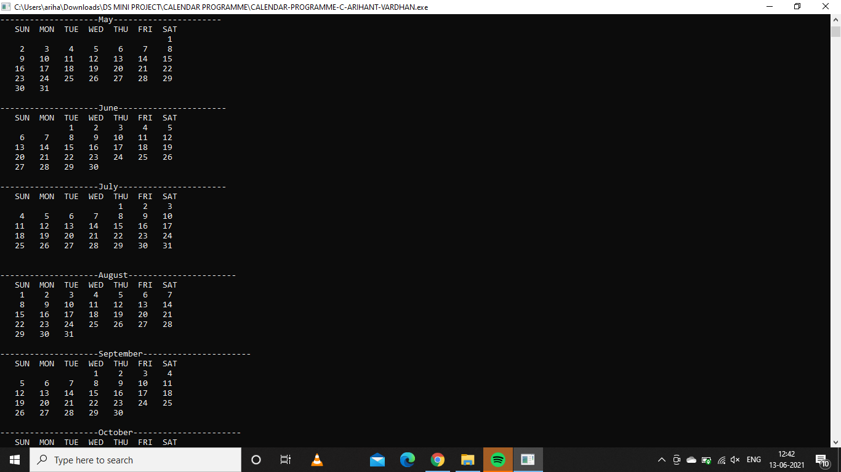
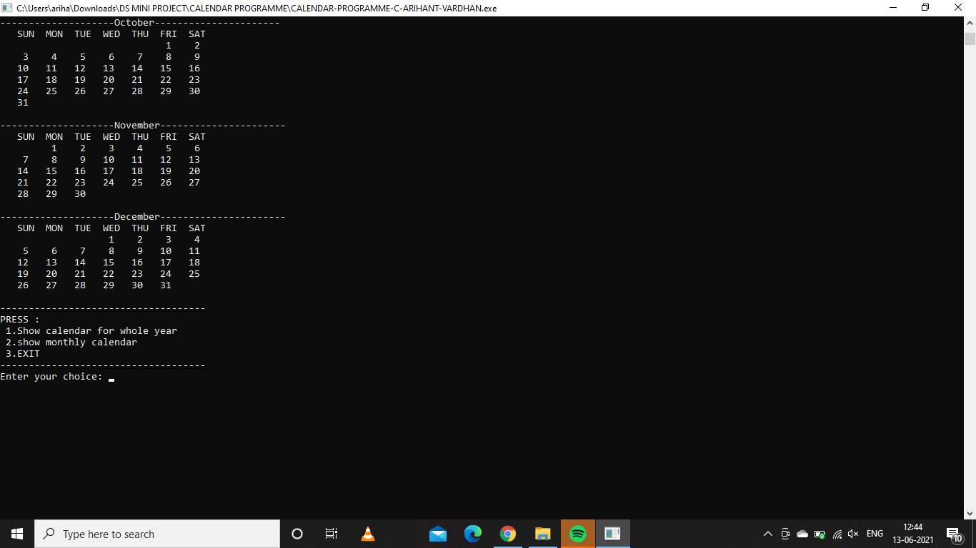
OUTPUT:
TEST CASE 1

Slide 18
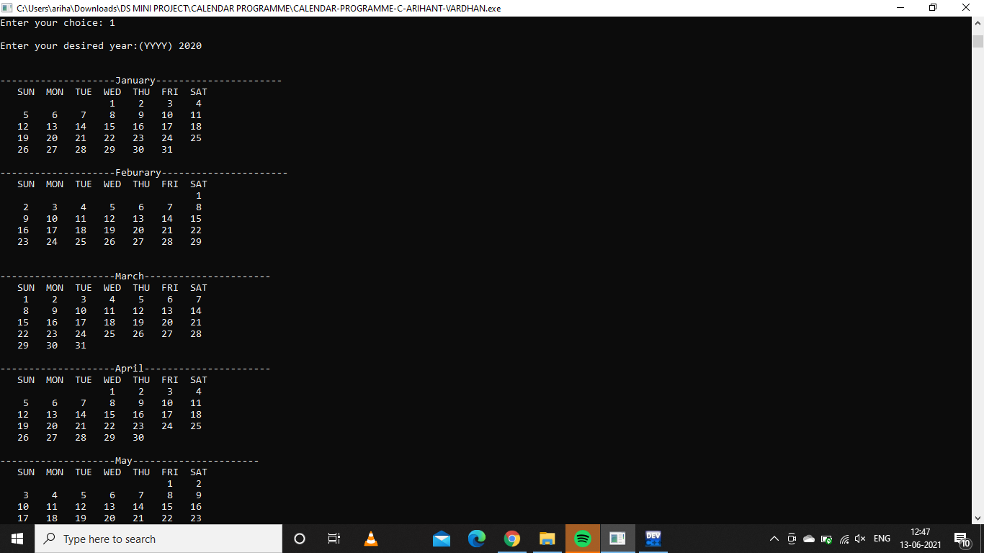
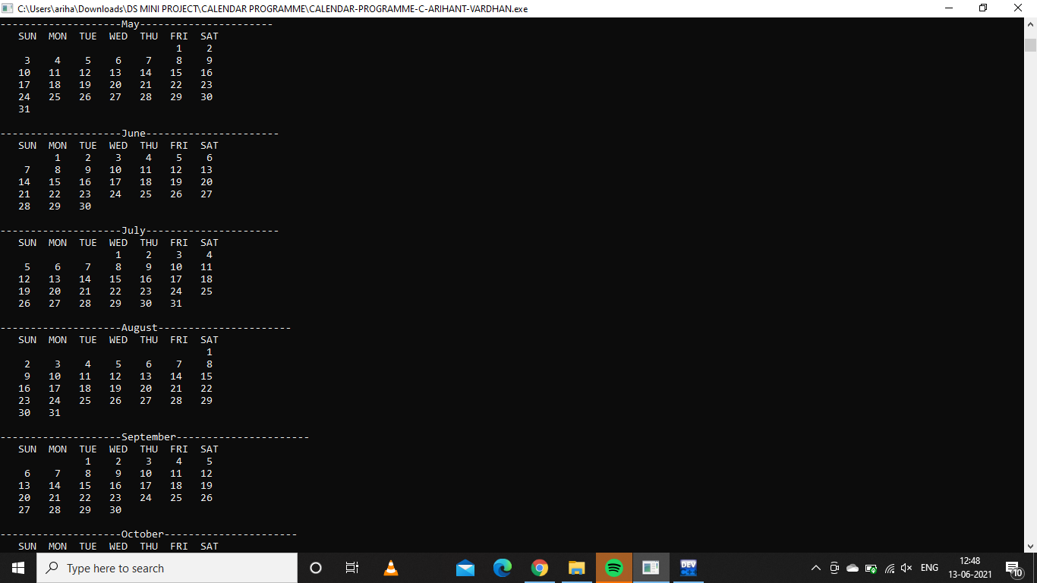
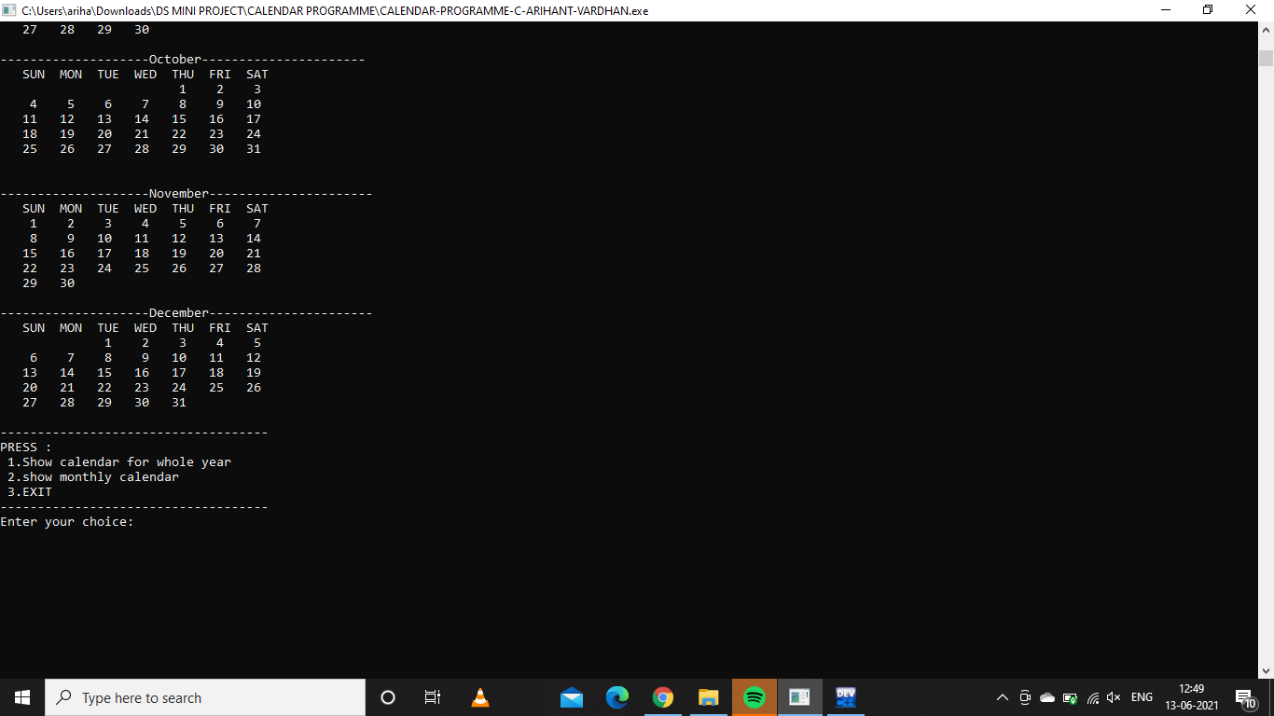
OUTPUT:
TEST CASE 2

Slide 19


OUTPUT:
TEST CASES 3 & 4

Slide 20
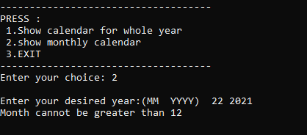
OUTPUT:
TEST CASE 6

Slide 21
CODE: (CALENDAR PROGRAM)
//gregorian calendar
#include <stdio.h>
#include <stdlib.h>
int yearlyCalendar(){
int year,month,day,daysInMonth,weekDay=0,firstDay;
int monthDay[]={31,28,31,30,31,30,31,31,30,31,30,31};
char *months[]={"January","Feburary","March","April","May","June","July","August","September","October","November","December"};
printf("\nEnter your desired year:(YYYY) ");

Slide 22
CODE: (Contd...)
scanf("%d",&year);
if(year%4==0&&year%100!=0){
monthDay[1]=29;
}
else if(year%400==0){
monthDay[1]=29;
}
else{
monthDay[1]=28;
}
firstDay=get_First_weekday(year);

Slide 23
CODE: (Contd...)
for(month=0;month<12;month++){
daysInMonth=monthDay[month];
printf("\n\n--------------------%s----------------------",months[month]);
printf("\n SUN MON TUE WED THU FRI SAT\n");
for(weekDay=0;weekDay<firstDay;weekDay++){
printf(" ");
}
for(day=1;day<=daysInMonth;day++){
printf("%5d",day);
if(++weekDay>6){
printf("\n");
weekDay=0; //It is essential to again initialize it to zero otherwise it will only run ones
}
firstDay=weekDay;
}
}
}

Slide 24
CODE: (Contd...)
int monthlyCalendar(){
int year,month,day,daysInMonth,weekDay=0,firstDay;
int monthDay[]={31,28,31,30,31,30,31,31,30,31,30,31};
char *months[]={"January","Feburary","March","April","May","June","July","August","September","October","November","December"};
printf("\nEnter your desired year:(MM YYYY) ");
scanf("%d%d",&month,&year);
if(month<=12){
if(year%4==0&&year%100!=0){
monthDay[1]=29;
}

Slide 25
CODE: (Contd...)
else if(year%400==0){
monthDay[1]=29;
}
else{
monthDay[1]=28;
}
firstDay=dayOfWeek(month,year);
month=month-1;
daysInMonth=monthDay[month];
printf("\n\n--------------------%s----------------------",months[month]);
printf("\n SUN MON TUE WED THU FRI SAT\n");
printf("\n");
for(weekDay=0;weekDay<firstDay;weekDay++){
printf(" ");
}

Slide 26
CODE: (Contd...)
for(day=1;day<=daysInMonth;day++){
printf("%5d",day);
if(++weekDay>6){
printf("\n");
weekDay=0; //It is essential to again initialize it to zero otherwise it will only run ones
}
firstDay=weekDay;
}
}
else{
printf("Month cannot be greater than 12");
}
}

Slide 27
CODE: (Contd...)
int dayOfWeek(int month,int year){
int d=1;
static int t[] = {0, 3, 2, 5, 0, 3, 5, 1, 4, 6, 2, 4};
if(m<3)
{y=y-1;
}
return (y + y/4 - y/100 + y/400 + t[m-1] + d) % 7;
}

Slide 28
CODE: (Contd...)
int get_First_weekday(int year){
int day;
day = (((year - 1) * 365) + ((year - 1) / 4) - ((year - 1) / 100) + ((year) / 400) + 1) % 7; // this algo will return 0 for Sunday and 6 for Saturday only works for january
return day;
}
int main()
{
system("Color 0F"); //System fn is called here to add back ground color 0= black and text color F= white
int choice;

Slide 29
CODE: (Contd...)
do{
printf("\n\n------------------------------------\n");
printf("PRESS :\n 1.Show calendar for whole year\n 2.show monthly calendar\n 3.EXIT" );
printf("\n------------------------------------\n");
printf("Enter your choice: ");
scanf("%d",&choice);
switch(choice){
case 1:
yearlyCalendar();
break;

Slide 30
CODE: (Contd...)
case 2:
monthlyCalendar();
break;
case 3:
printf("\nExiting program\n");
break;
default:
printf("\nEntered choice doesn't exist ... please enter correct value\n ");
}
}while(choice!=3);
return 0;
}

Slide 31
QUIZ PROGRAM -
NAME: ​ | SAP ID: ​ | ROLL NO. ​
ARIHANT VARDHAN ​ | 500086019 ​ | R2142201523 ​
ADARSH TRIPATHI ​ | 500086025 ​ | R2142201527 ​

Slide 32
ABOUT MY QUIZ PROGRAM:
THE QUIZ PROGRAM I HAVE CREATED HAS BEEN CREATED USING C –LANGUAGE.
THE QUIZ PROGRAM HAS FOUR OPTION:
>>START PLAYING> TO START THE QUIZ.
>>SEE SCORECARD>TO SEE THE SCORES OF VARIOUS PERSONS WHO HAVE PLAYED THE QUIZ.
>>OPEN HELP> TO OPEN HELP MENU AND SEE THE INSTRUCTIONS
>>EXIT>TO EXIT THE PROGRAM
TO ACHIEVE THESE FUNCTION IN MY PROGRAM I CREATED THREE FN'S:
>>start()>TO START THE QUIZ ,TAKE NAME OF PARTICIPANT AND DISPLAY THE QUESTIONS AND TAKE ANSWERS FROM USERS AND CHECK IF ITS CORRECT OR NOT. ALSO, ADD SCORE FOR EACH PLAYER AND APPEND THE FINAL SCORE IN A TEXT FILE (C:arihant.txt) CORRESPONDING TO NAME OF PLAYER IF IT IS GREATER THAN ZERO.ELSE PRINT TRY AGAIN.
>>scoreboard()>TO DISPLAY THE SCORE & NAME OF EVERY PLAYER WHO HAD SCORED MORE THAN ZERO IN QUIZ BY READING IT FROM TEXT FILE (C:arihant.txt) .
>>help()>TO DISPLAY THE INSTRUCTION OF THE QUIZ

Slide 33
ALGORITHM:

Slide 34
START
STEP 1: include <stdio.h> and <stdlib.h>
STEP 1.1:struct play[declare struct]
STEP 1.2:char fname[20];[declare inside struct play]
STEP 1.3: char lname[20];[declare inside struct play]
STEP 1.4:int score;[declare inside struct play]
STEP 1.5:The variable p is declared with 'play';
STEP 2: in main fn:
STEP 2.1:system("Color 70");[set the background color as white with 7 and 0 to set text color as black]
STEP 2.2:[declare] int choice=0;
STEP 2.3:repeat through step 2.11 While choice!=4;[using exit controlled loop]
STEP 2.4: PRINT THE MENU;
STEP 2.5:input choice
STEP 2.6:[using switch case check value of choice]switch(choice);

Slide 35
STEP 2.7:If choice =1, then call start();break;
STEP 2.8:If choice=2, then call scoreboard();break;
STEP 2.9:If choice=3, then call help();break;
STEP 2.10: If choice=4, then print exiting and exit loop;break;
STEP 2.11:for default PRINT oops ! you entered wrong choice;
STEP 3: In help() fn;
STEP 3.1: Print the instruction and details of the quiz;
STEP 4:In start() fn:[ this fn when called will take the name of participation display the questions of the quiz take answer from the user check if its correct and add the final score to text file with name of player if score is greater than zero else print You scored Zero , Try again!]
STEP 4.1:[DECLARE] int ans, count=0;
STEP 4.2: FILE *fp; [FILE POINTER]
STEP 4.3: if((fp=fopen("C:arihant.txt","a"))==NULL) [will create a file] ;print Empty file;
STEP 4.4: use p.fname to store the first name of player;

Slide 36
STEP 4.5: use p.lname to store the last name of player;
STEP 4.5: print welcome (name of player ) to c quiz;
STEP 4.6:name of player is printed in step 4.5 with the use of escape sequence; printf("******************* Welcome \" %s %s\" to C Quiz Game *************************** \n\n", p.fname,p.lname);
STEP 4.7:print the 10 questions one by one and take answer for each question in int options between 1-4, if ans is correct print Correct! +10 points and increase the count= count+1;else print Wrong answer! Correct answer is...(correct answer);
STEP 4.8:if count > 0 then print scored marks and then store in p.score=count*10; now write the p.score in file using fprintf(fp,"%s %s %d", p.fname,p.lname,p.score); fclose(fp);[to close the file after addind score and player name to text file][upon successful completion fclose() returns 0];
STEP 4.9:else print You scored Zero , Try again!
STEP 5:In scoreboard() fn:[when called will display the score of each player who has scored more than zero with there name];
STEP 5.1: FILE *fp; [FILE POINTER]

Slide 37
STEP 5.2:if((fp=fopen("C:arihant.txt", "r"))==NULL) [reading the file] then print No games played yet!
STEP 5.3:else print scores by reading it from file using fscan
STEP 5.4:while(fscanf(fp,"%s %s %d",p.fname,p.lname,&p.score) !=EOF) [THIS WILL READ THE NAME AND SCORE OF PLAYERS IN TEXT FILE]
STEP 5.5:printf("%s %s %d \n\n",p.fname,p.lname,p.score); [PRINT THE NAME AND SCORE OF EACH PLAYER]
STEP 5.6:END WHILE;
STEP 5.7: fclose(fp);
END

Slide 38
FLOWCHART:

Slide 39
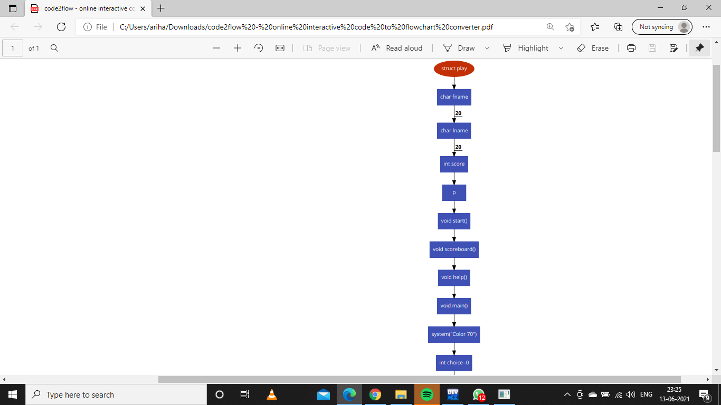
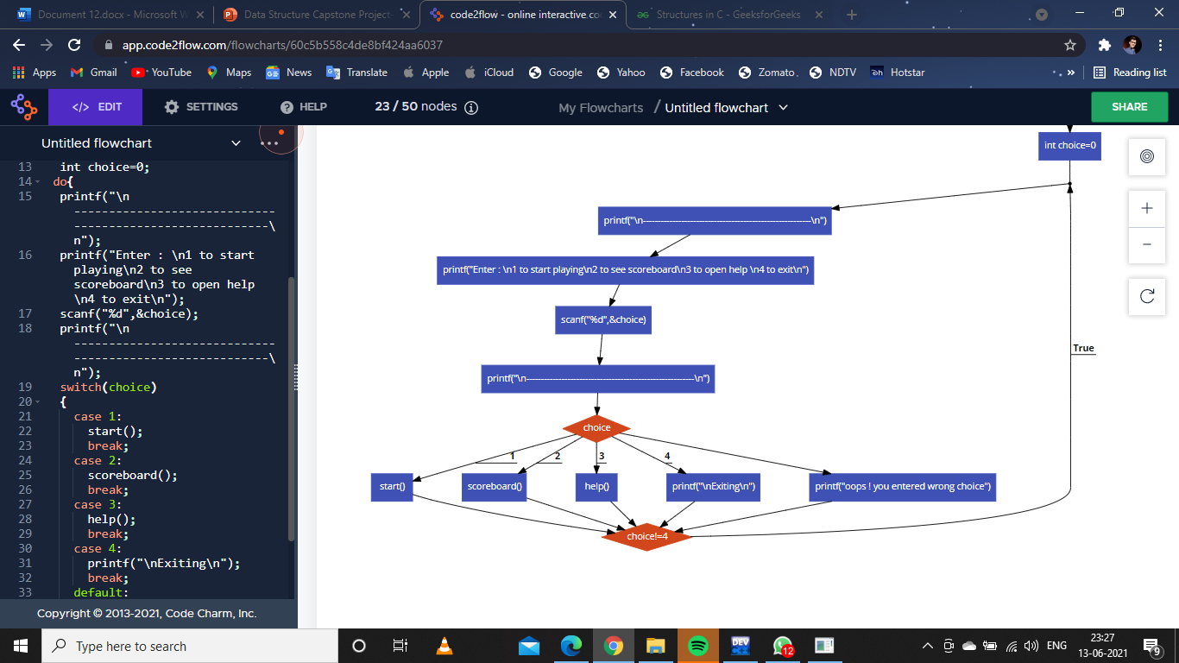
FIG 1
FIG 2
FIG 3

Slide 40
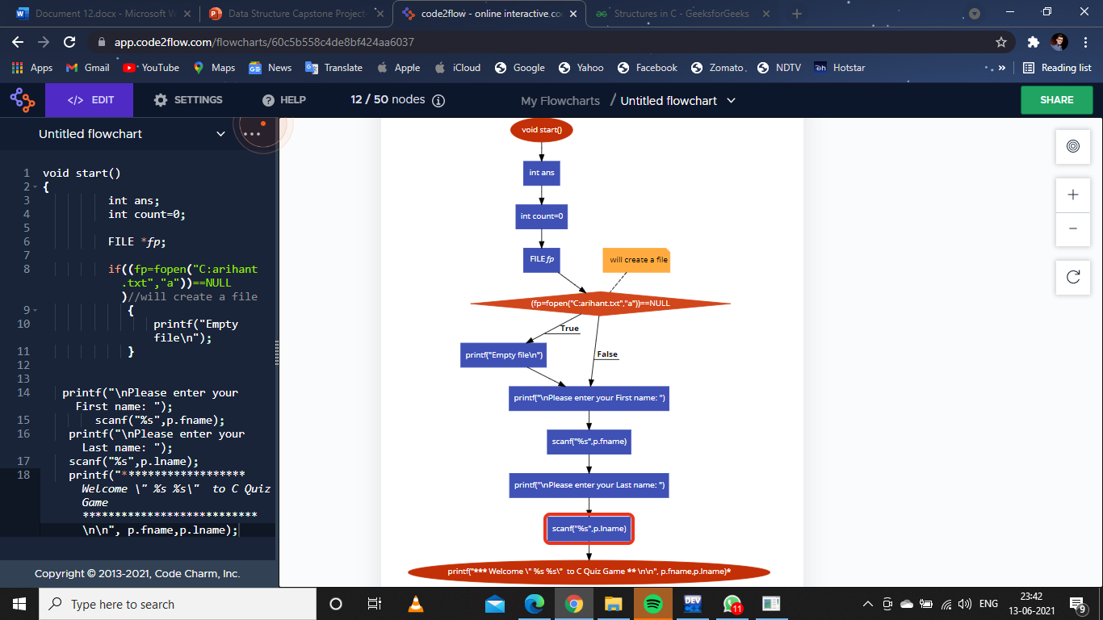
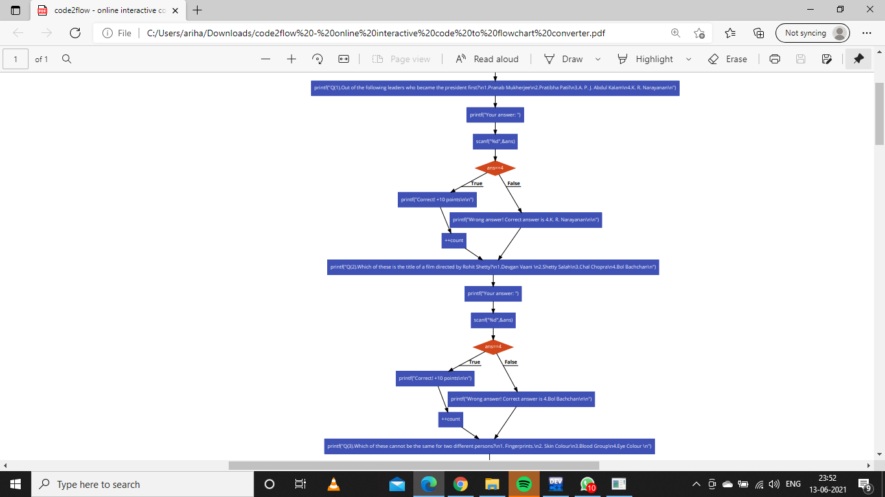
FIG 1

Slide 41
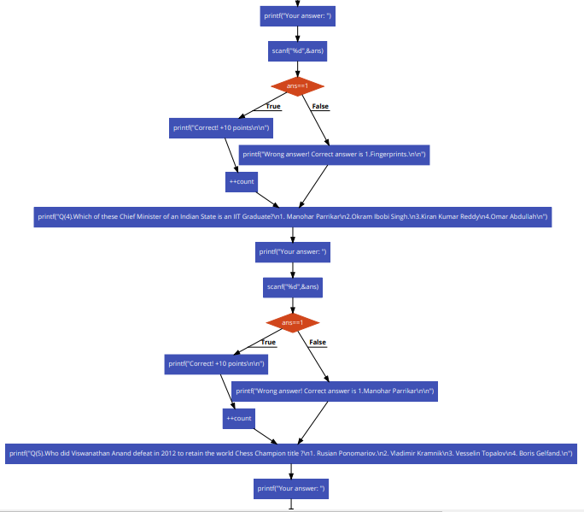
FIG 1 CONTINUED...

Slide 42
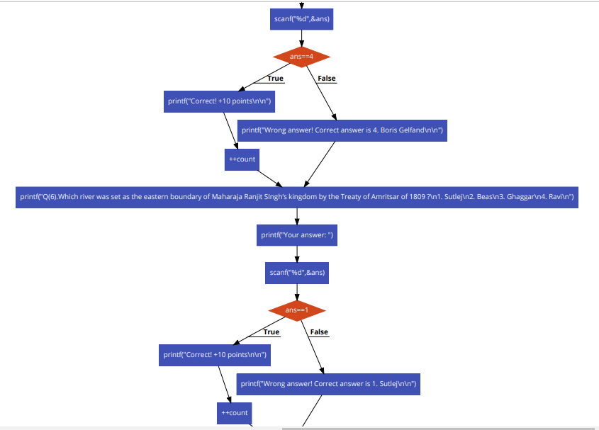
FIG 1 CONTINUED...

Slide 43
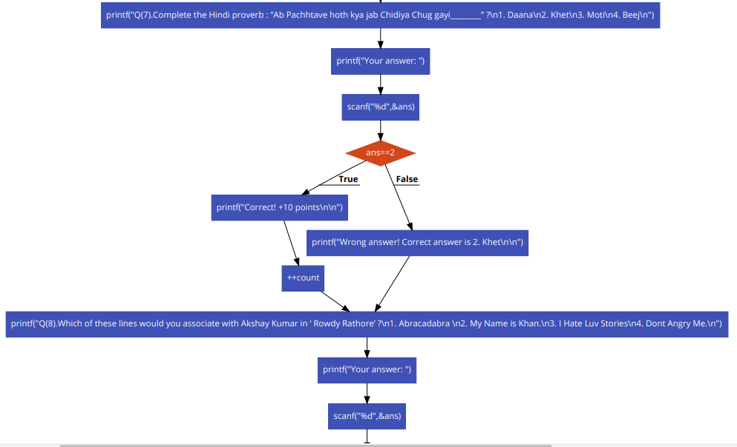
FIG 1 CONTINUED...

Slide 44
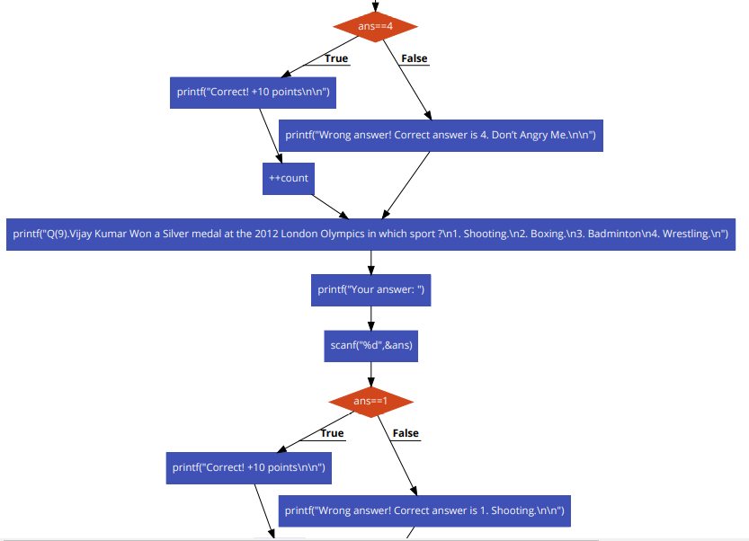
FIG 1 CONTINUED...

Slide 45
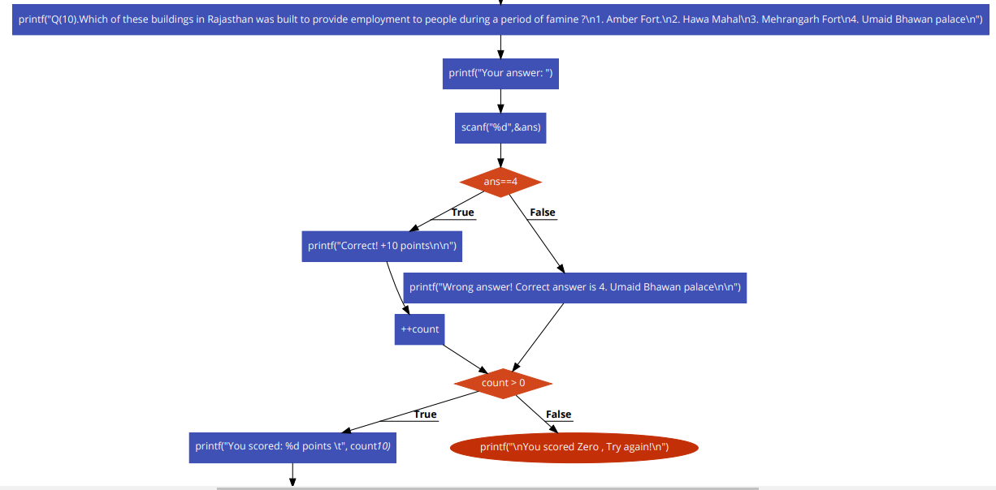
FIG 1 CONTINUED...

Slide 46
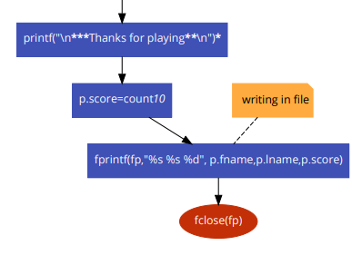
FIG 1 CONTINUED...

Slide 47
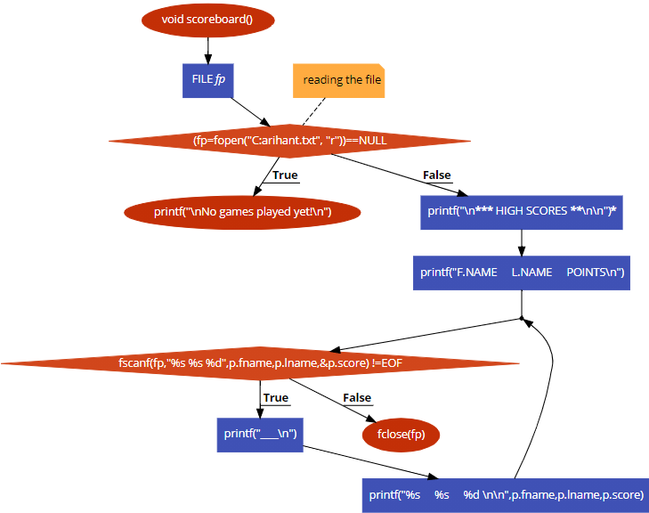
FIG 2

Slide 48
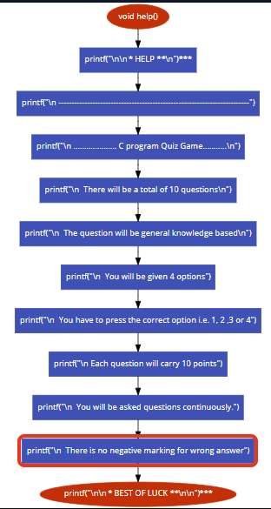
FIG 3

Slide 49
FUNCTIONS USED IN PROJECT:
Predefined fn included with stdio.h,conio.h and stdlib.h:
printf(): To print .
scanf():To take input.
fopen(): to open the text file
fscanf(): to scan the text file that is opened
fprintf(): to write into the text file
Userdefined fn in the program:
start()>TO START THE QUIZ ,TAKE NAME OF PARTICIPANT AND DISPLAY THE QUESTIONS AND TAKE ANSWERS FROM USERS AND CHECK IF ITS CORRECT OR NOT. ALSO, ADD SCORE FOR EACH PLAYER AND APPEND THE FINAL SCORE IN A TEXT FILE (C:arihant.txt) CORRESPONDING TO NAME OF PLAYER IF IT IS GREATER THAN ZERO.ELSE PRINT TRY AGAIN.
scoreboard()>TO DISPLAY THE SCORE & NAME OF EVERY PLAYER WHO HAD SCORED MORE THAN ZERO IN QUIZ BY READING IT FROM TEXT FILE (C:arihant.txt) .
help()>TO DISPLAY THE INSTRUCTION OF THE QUIZ
main(): user defined as well as predefined because it's prototype is predefined.It is the point at which execution of program is started.

Slide 50
TEST CASES:
TEST CASES | INPUT | ACTUAL OUTPUT | DESIRED OUTPUT
SELECT OPTION ONE AND CHECK IF THE SCORE IS GETTING STORED IN TEXT FILE OR NOT WHEN SCORE/POINTS > 0 | 1 SELECTING MORE THAN ONE CORRECT ANSWER IN QUIZ OUT OF 10 QUESTIONS | THE SCORE GETS STORED IN TEXT FILE. YOU SCORED (THE SCORE). E.G. YOU SCORED 50 | THE SCORE GETS STORED IN TEXT FILE. YOU SCORED (THE SCORE). E.G. YOU SCORED 50 | PASS
SELECT OPTION ONE AND CHECK IF A PERSON SCORES ZERO IT GETS SCORED IN TEXT FILE OR NOT | 1 SELECTING ZERO CORRECT ANSWER IN QUIZ OUT OF 10 QUESTIONS | IT DOESNOT GET STORED IN TEXT FILE. You scored Zero , Try again! | IT DOESNOT GET STORED IN TEXT FILE. You scored Zero , Try again! | PASS
SELECT OPTION ONE AND CHECK IF SCORES ARE CORRECTLY DISPLAYED | 1 FOR 6 CORRECT ANSWERS | You scored: 60 points | You scored: 60 points | PASS
SELECT OPTION TWO AND CHECK IF IT DISPLAYS THE STORED SCORES | 2 | IT DISPLAYS THE STORED SCORES | IT DISPLAYS THE STORED SCORES | PASS
SELECT OPTION THREE AND CHECK IF IT DISPLAYS THE INSTRUCTION FOR QUIZ | 3 | IT DISPLAYS INSTRUCTION FOR QUIZ. | IT DISPLAYS INSTRUCTION FOR QUIZ. | PASS
SELECT OPTION 4 AND CHECK IF PROGRAM CLOSES | 4 | EXISTS THE PROGRAM. | EXISTS THE PROGRAM. | PASS

Slide 51
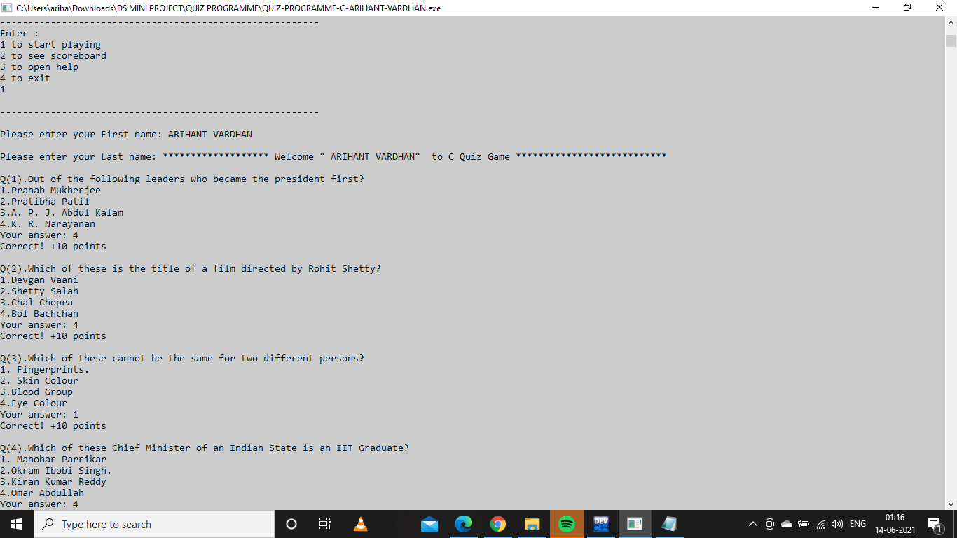
OUTPUT:
TEST CASE 1 & 3

Slide 52
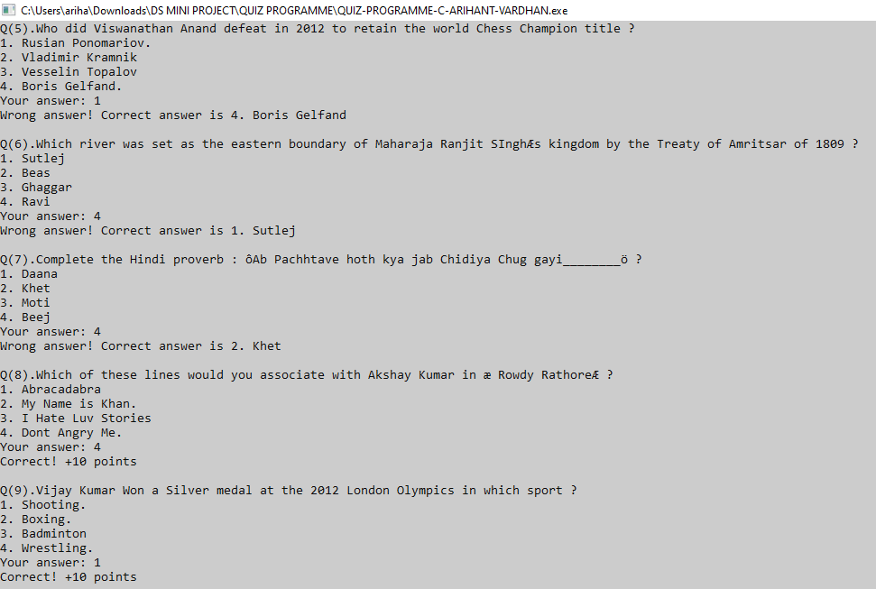
OUTPUT:
TEST CASE 1 & 3

Slide 53
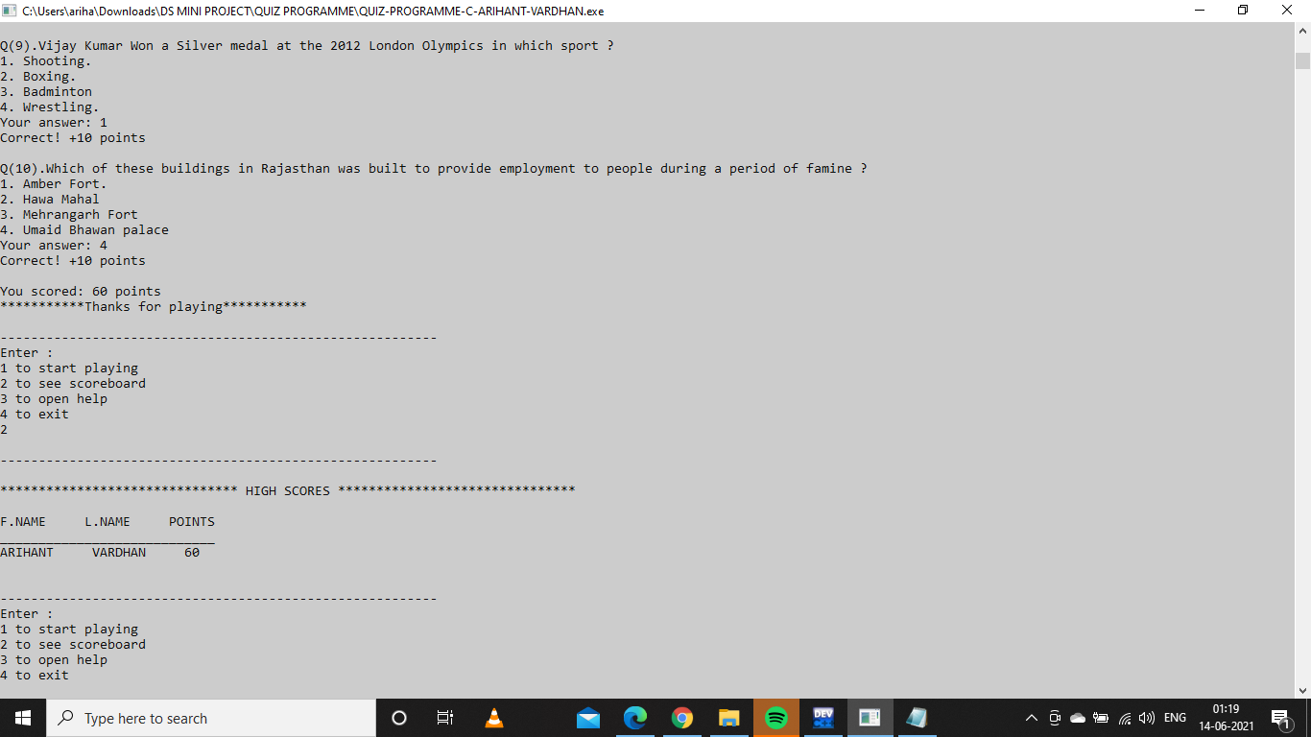
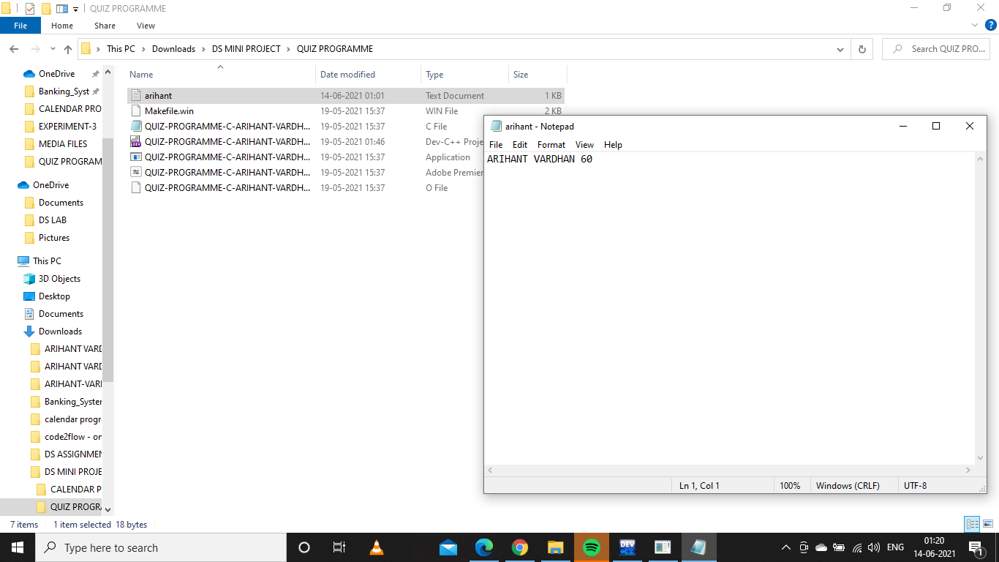
OUTPUT:
TEST CASE 1 & 3

Slide 54
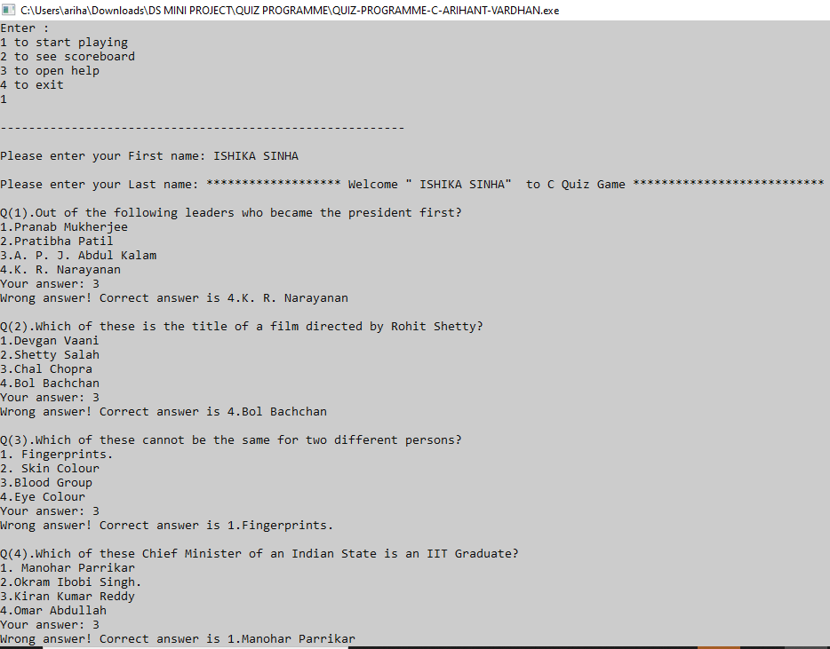
OUTPUT:
TEST CASE 2

Slide 55

OUTPUT:
TEST CASE 2

Slide 56
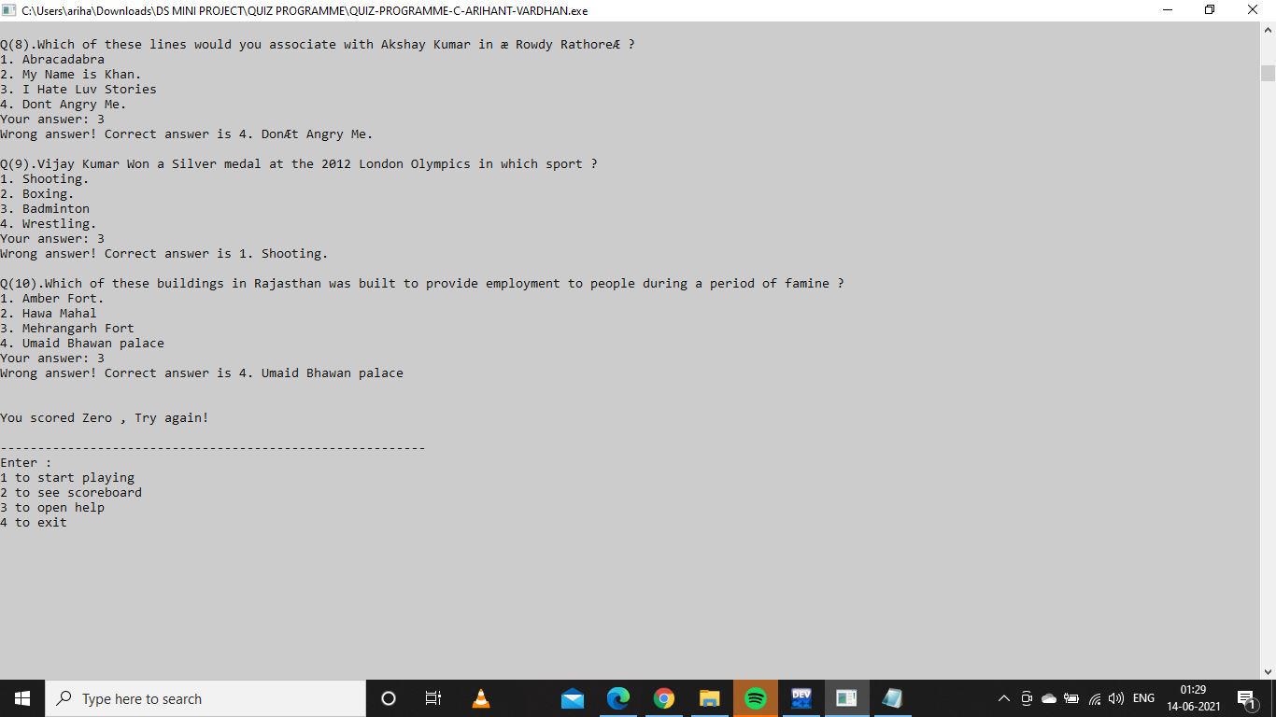
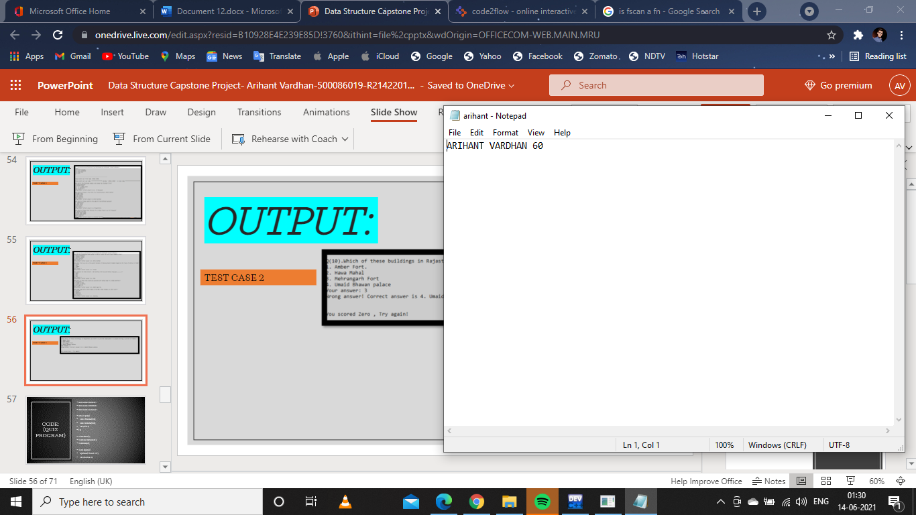
OUTPUT:
TEST CASE 2
Clearly for zero score it was not stored in the text file

Slide 57
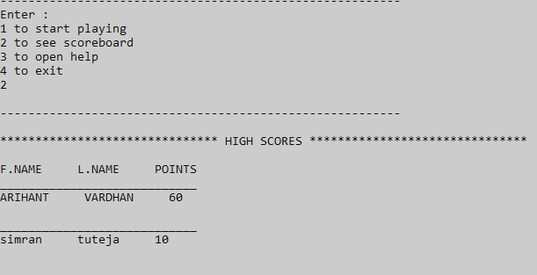
OUTPUT:
TEST CASE 4

Slide 58
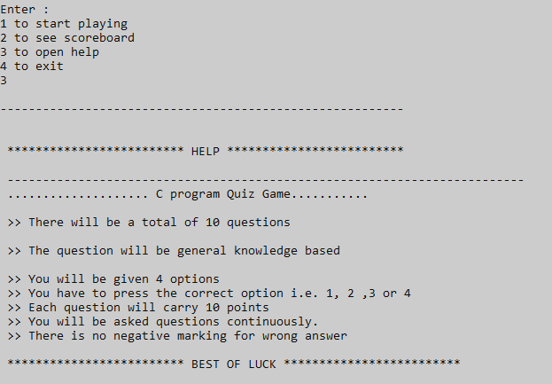
OUTPUT:
TEST CASE 5

Slide 59
CODE: (QUIZ PROGRAM)
#include<stdio.h>
#include<stdlib.h>
#include<conio.h>
struct play{
char fname[20];
char lname[20];
int score;
}p;
void start();
void scoreboard();
void help();
void main(){
system("Color 70");
int choice=0;

Slide 60
CODE: (Contd...)
do{
printf("\n---------------------------------------------------------\n");
printf("Enter : \n1 to start playing\n2 to see scoreboard\n3 to open help \n4 to exit\n");
scanf("%d",&choice);
printf("\n---------------------------------------------------------\n");
switch(choice)
{
case 1:
start();
break;
case 2:
scoreboard();
break;
case 3:
help();
break;
case 4:
printf("\nExiting\n");
break;
default:
printf("oops ! you entered wrong choice");
}
}while (choice!=4);
}

Slide 61
CODE: (Contd...)
void help(){
printf("\n\n ************************* HELP *************************\n");
printf("\n -------------------------------------------------------------------------");
printf("\n .................... C program Quiz Game...........\n");
printf("\n >> There will be a total of 10 questions\n");
printf("\n >> The question will be general knowledge based\n");
printf("\n >> You will be given 4 options");
printf("\n >> You have to press the correct option i.e. 1, 2 ,3 or 4");
printf("\n >> Each question will carry 10 points");
printf("\n >> You will be asked questions continuously.");
printf("\n >> There is no negative marking for wrong answer");
printf("\n\n ************************* BEST OF LUCK *************************\n\n");
}

Slide 62
CODE: (Contd...)
void start()
{
int ans;
int count=0;
FILE *fp;
if((fp=fopen("C:arihant.txt","a"))==NULL)//will create a file
{
printf("Empty file\n");
}
printf("\nPlease enter your First name: ");
scanf("%s",p.fname);
printf("\nPlease enter your Last name: ");
scanf("%s",p.lname);

Slide 63
CODE: (Contd...)
printf("******************* Welcome \" %s %s\" to C Quiz Game *************************** \n\n", p.fname,p.lname);
printf("Q(1).Out of the following leaders who became the president first?\n1.Pranab Mukherjee\n2.Pratibha Patil\n3.A. P. J. Abdul Kalam\n4.K. R. Narayanan\n");
printf("Your answer: ");
scanf("%d",&ans);
if(ans==4)
{
printf("Correct! +10 points\n\n");
++count;
}
else
{
printf("Wrong answer! Correct answer is 4.K. R. Narayanan\n\n");
}

Slide 64
CODE: (Contd...)
printf("Q(2).Which of these is the title of a film directed by Rohit Shetty?\n1.Devgan Vaani \n2.Shetty Salah\n3.Chal Chopra\n4.Bol Bachchan\n");
printf("Your answer: ");
scanf("%d",&ans);
if(ans==4)
{
printf("Correct! +10 points\n\n");
++count;
}
else
{
printf("Wrong answer! Correct answer is 4.Bol Bachchan\n\n");
}
printf("Q(3).Which of these cannot be the same for two different persons?\n1. Fingerprints.\n2. Skin Colour\n3.Blood Group\n4.Eye Colour \n");
printf("Your answer: ");
scanf("%d",&ans);

Slide 65
CODE: (Contd...)
if(ans==1)
{
printf("Correct! +10 points\n\n");
++count;
}
else
{
printf("Wrong answer! Correct answer is 1.Fingerprints.\n\n");
}
printf("Q(4).Which of these Chief Minister of an Indian State is an IIT Graduate?\n1. Manohar Parrikar\n2.Okram Ibobi Singh.\n3.Kiran Kumar Reddy\n4.Omar Abdullah\n");
printf("Your answer: ");
scanf("%d",&ans);
if(ans==1)
{
printf("Correct! +10 points\n\n");
++count;
}

Slide 66
CODE: (Contd...)
else
{
printf("Wrong answer! Correct answer is 1.Manohar Parrikar\n\n");
}
printf("Q(5).Who did Viswanathan Anand defeat in 2012 to retain the world Chess Champion title ?\n1. Rusian Ponomariov.\n2. Vladimir Kramnik\n3. Vesselin Topalov\n4. Boris Gelfand.\n");
printf("Your answer: ");
scanf("%d",&ans);
if(ans==4)
{
printf("Correct! +10 points\n\n");
++count;
}
else
{
printf("Wrong answer! Correct answer is 4. Boris Gelfand\n\n");
}

Slide 67
CODE: (Contd...)
printf("Q(6).Which river was set as the eastern boundary of Maharaja Ranjit SIngh’s kingdom by the Treaty of Amritsar of 1809 ?\n1. Sutlej\n2. Beas\n3. Ghaggar\n4. Ravi\n");
printf("Your answer: ");
scanf("%d",&ans);
if(ans==1)
{
printf("Correct! +10 points\n\n");
++count;
}
else
{
printf("Wrong answer! Correct answer is 1. Sutlej\n\n");
}

Slide 68
CODE: (Contd...)
printf("Q(7).Complete the Hindi proverb : “Ab Pachhtave hoth kya jab Chidiya Chug gayi________” ?\n1. Daana\n2. Khet\n3. Moti\n4. Beej\n");
printf("Your answer: ");
scanf("%d",&ans);
if(ans==2)
{
printf("Correct! +10 points\n\n");
++count;
}
else
{
printf("Wrong answer! Correct answer is 2. Khet\n\n");
}

Slide 69
CODE: (Contd...)
printf("Q(8).Which of these lines would you associate with Akshay Kumar in ‘ Rowdy Rathore’ ?\n1. Abracadabra \n2. My Name is Khan.\n3. I Hate Luv Stories\n4. Dont Angry Me.\n");
printf("Your answer: ");
scanf("%d",&ans);
if(ans==4)
{
printf("Correct! +10 points\n\n");
++count;
}
else
{
printf("Wrong answer! Correct answer is 4. Don’t Angry Me.\n\n");
}

Slide 70
CODE: (Contd...)
printf("Q(9).Vijay Kumar Won a Silver medal at the 2012 London Olympics in which sport ?\n1. Shooting.\n2. Boxing.\n3. Badminton\n4. Wrestling.\n");
printf("Your answer: ");
scanf("%d",&ans);
if(ans==1)
{
printf("Correct! +10 points\n\n");
++count;
}
else
{
printf("Wrong answer! Correct answer is 1. Shooting.\n\n");
}

Slide 71
CODE: (Contd...)
printf("Q(10).Which of these buildings in Rajasthan was built to provide employment to people during a period of famine ?\n1. Amber Fort.\n2. Hawa Mahal\n3. Mehrangarh Fort\n4. Umaid Bhawan palace\n");
printf("Your answer: ");
scanf("%d",&ans);
if(ans==4)
{
printf("Correct! +10 points\n\n");
++count;
}
else
{
printf("Wrong answer! Correct answer is 4. Umaid Bhawan palace\n\n");
}

Slide 72
CODE: (Contd...)
if(count > 0)
{
printf("You scored: %d points \t", count*10);
printf("\n***********Thanks for playing***********\n");
p.score=count*10;
fprintf(fp,"%s %s %d", p.fname,p.lname,p.score); //writing in file
fclose(fp);
}
else
{
printf("\nYou scored Zero , Try again!\n");
}
}

Slide 73
CODE: (Contd...)
void scoreboard()
{
FILE *fp;
if((fp=fopen("C:arihant.txt", "r"))==NULL) //reading the file
{
printf("\nNo games played yet!\n");
}
else
{
printf("\n******************************* HIGH SCORES *******************************\n\n");
printf("F.NAME L.NAME POINTS\n");
while(fscanf(fp,"%s %s %d",p.fname,p.lname,&p.score) !=EOF)
{
printf("____________________________\n");
printf("%s %s %d \n\n",p.fname,p.lname,p.score);
}
fclose(fp);
}
}

